Slide 1
CSY3025 T2 overview

Slide 2
What is AI?
Symbolic AI
Rule-based systems (“if temp<19°C, heating on”)
human knowledge, machine execution
Machine learning
human architect
by techniques:
Conventional (shallow) learning
Deep learning – neural networks
by purpose:
Supervised learning – classification, regression (“this is a cat, that is a dog.”)
Unsupervised learning – clustering (“animals in two groups”)
Symbolic AI
Conventional ML
Machine learning
Human experience
Deep Learning
Complexity

Slide 3

Symbolic AI
Symbolic AI
Conventional learning
Deep learning
Observations
Rules
Actions
Human readable rules
+ Simple
+ Explainable
- Human error / conflict / bias
- Complex problems
Observations (sensor network)
Rules:
When Temp below 19°C:
6am-10pm
People home
Temp trend
Action:
Boost heating

Slide 4
Shallow Machine learning
Symbolic AI
Conventional learning
Deep learning
Conventional data modelling
Human learning assisted by data analysis.
Regression
Time series data (trend analysis, forecasting)
Image classification (quality inspection)

Slide 5
Shallow Machine learning
Symbolic AI
Conventional learning
Deep learning
Conventional data modelling
Human learning assisted by data analysis.
Regression
Time series data (trend analysis, forecasting)
Image classification (quality inspection)

Slide 6
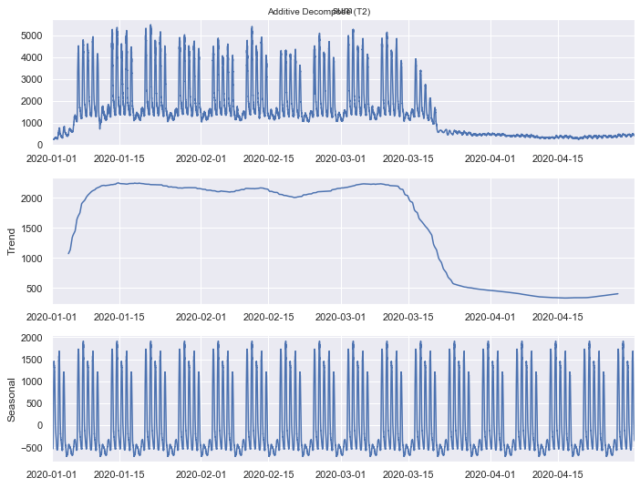
Trend analysis
Crowd on Waterside Campus
Autoregressive integrated moving average (ARIMA)
Time series decomposition for trend analysis

Slide 7
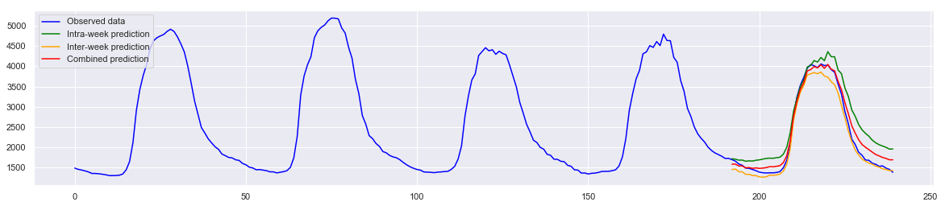
Forecasting and anomaly detection
Forecasting Friday data using inter- and intra-week prediction
Monday Tuesday Wednesday Thursday Friday

Slide 8
Shallow Machine learning
Symbolic AI
Conventional learning
Deep learning
Conventional data modelling
Human learning assisted by data analysis.
Regression
Time series analysis (trend analysis, forecasting)
Image classification

Slide 9
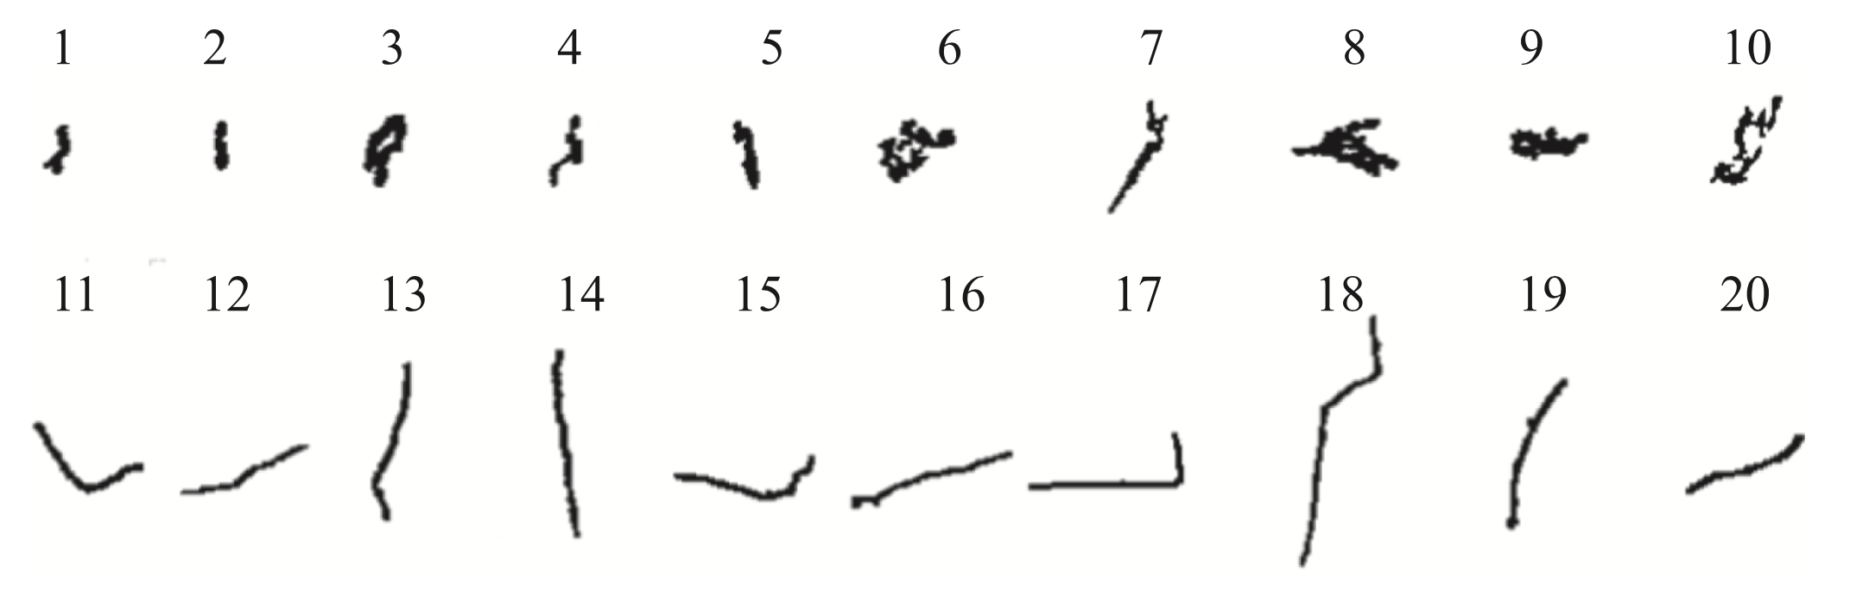
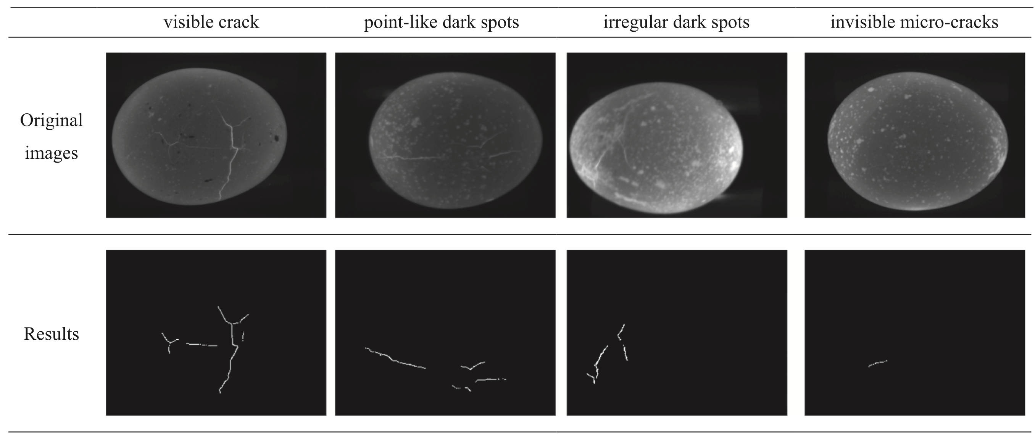
Cracked egg?
no crack
crack
Edge detection image filters
DOI: 10.1016/j.compag.2019.01.005

Slide 10
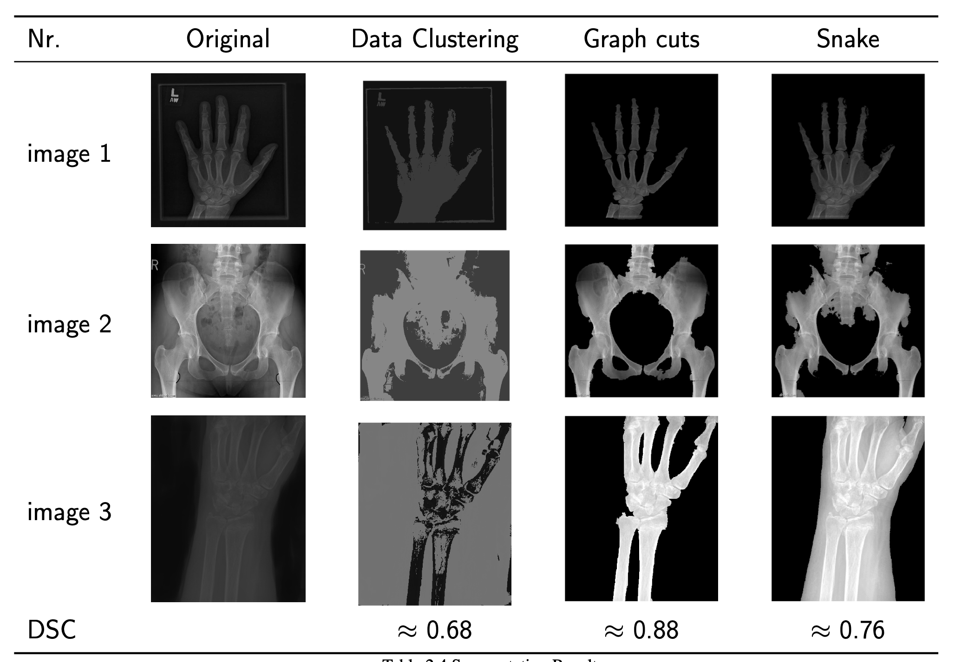
Image segmentation

Slide 11
Deep Machine learning
Symbolic AI
Conventional learning
Deep learning
Deep learning, Neural Networks
+ Complex challenges
+ Humans set the training framework and data.
+ Machines use brutal force to train then make inferences.
- Require data to learn
Classification
Object detection

Slide 12
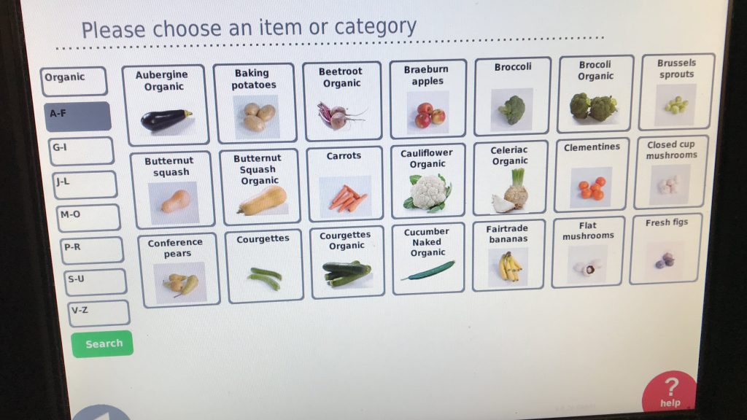
AI assignment: Fruit and vegetables
Develop a machine learning model to recognise fruit and vegetables for customers at self checkout

Slide 13
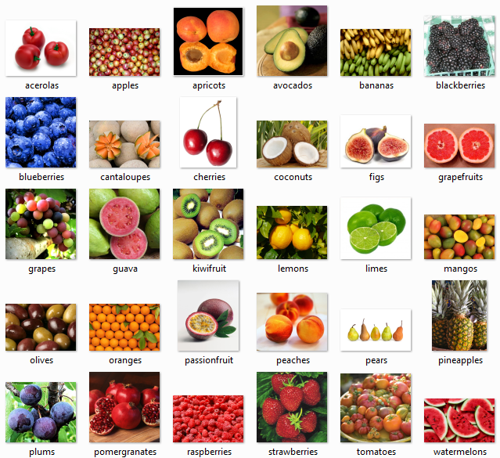
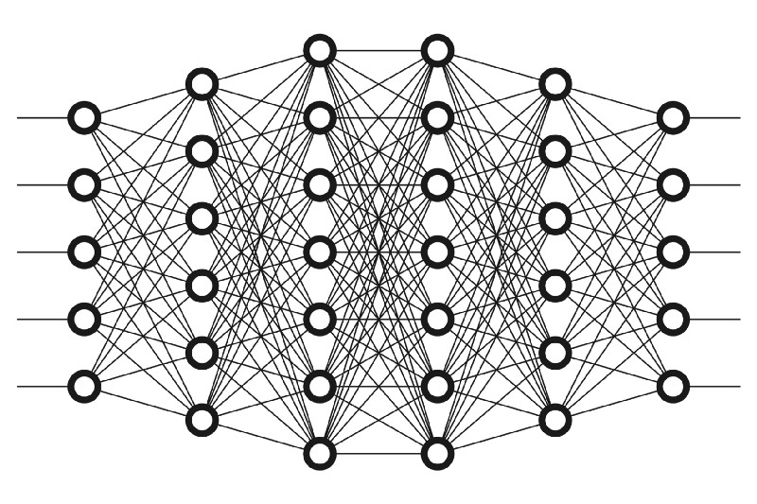
Deep Machine learning
1. Neural network (structure, weights)
2. Data
3. Kiwi?
4. Optimiser (adjusting weights based on how wrong the prediction was)

Slide 14
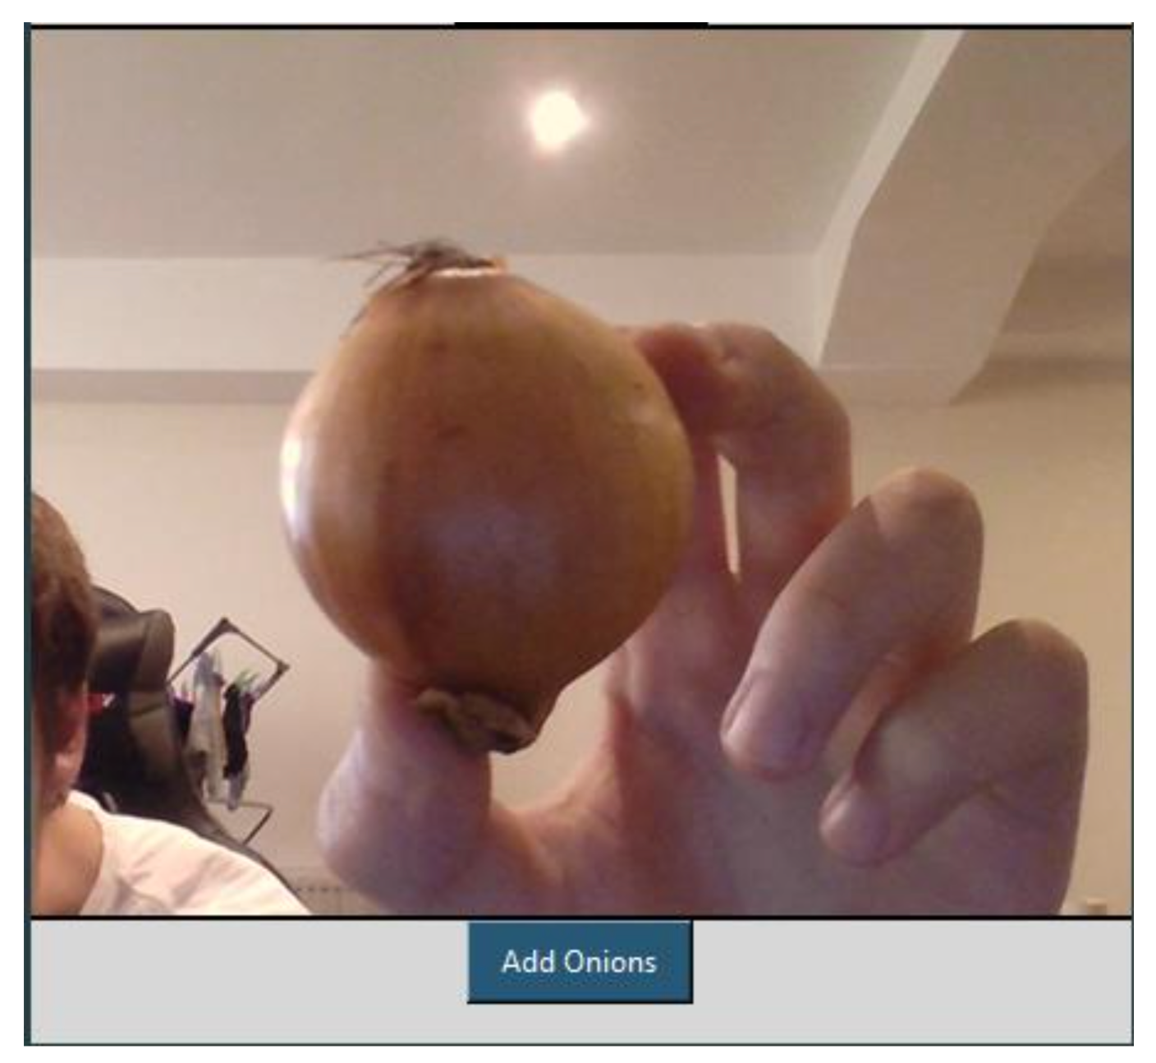
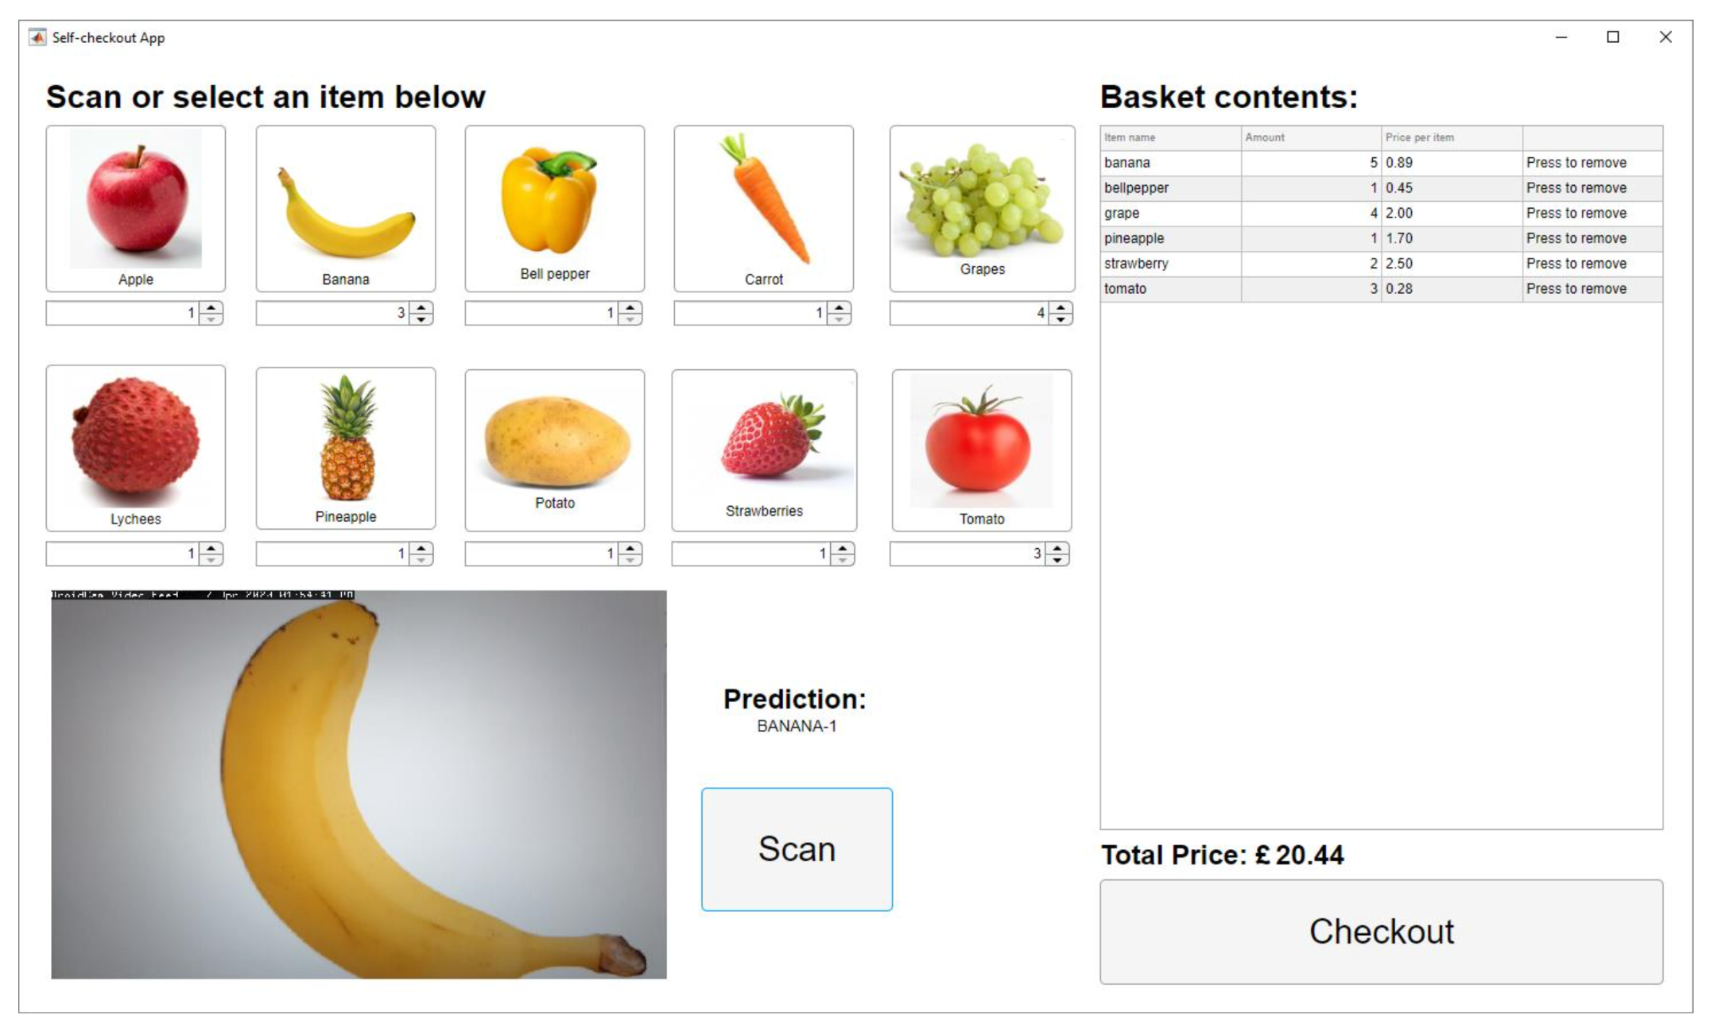
Student projects

Slide 15
T2 planning
Regression
SVM
Clustering
Decision trees
Random forest
NLP
…

Slide 16
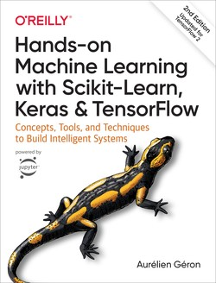
Reference book
Hands-On Machine Learning with Scikit-Learn, Keras, and TensorFlow, 2nd Edition by Aurélien Géron
https://github.com/ageron/handson-ml2
Python
Google Colab

Slide 17
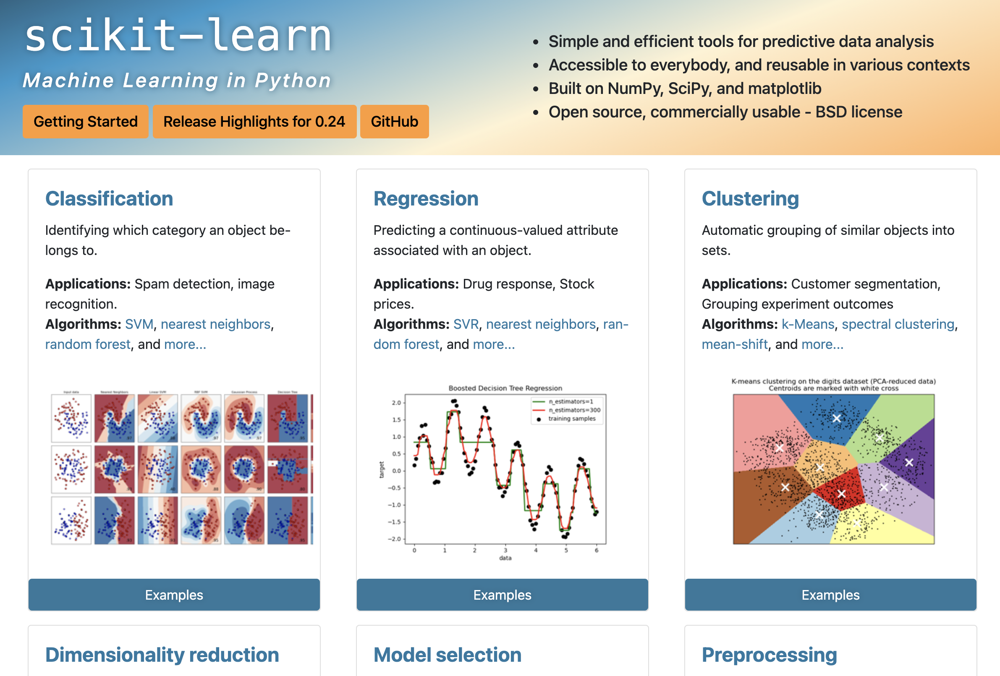

Slide 18
Assessment 2
Research and prototyping
Autonomous vehicles and Transportation
Health and Wellbeing
Manufacturing
Education and Training
Finance and Retail
Virtual assistance
Report
Background and problem space – 20%
Literature review – 40%
Prototype – 30%
Technical writing – 10%

